Slide 1
MySQL 5.6 GTID (Global Transaction Identifier)

Slide 2
What is GTID?
New way of replicating data across servers.
Each transaction is assigned a Unique Identifier.
It is unique across all the servers in the replication setup.
In MySQL 5.6, a new file is created in the data directory ‘auto.cnf’ which stores the server’s UUID.
GTID = source server’s UUID + sequence no.
Sequence Range
3E11FA47-71CA-11E1-9E33-C80AA9429562:1-5

Slide 3
Why do we need it?
Presently, to failover we need to stop all writes to Master then fetch the ‘Master Status’ from the intended Master.
Use this Master Status to run ‘Change Master To’ on all slaves and start slaving.
GTID gives us the ability to auto failover.
High Availability. No need to stop writes.
CHANGE MASTER TO MASTER_HOST = ‘Master’, MASTER_USER = 'rep_user', MASTER_PASSWORD = ‘password’, MASTER_LOG_FILE='mysql-bin.005815', MASTER_LOG_POS=1010885643
CHANGE MASTER TO MASTER_HOST = ‘Master’, MASTER_USER = 'rep_user', MASTER_PASSWORD = ‘password’, MASTER_AUTO_POS =1

Slide 4
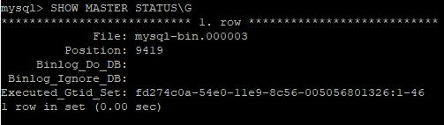
New Master Status

Slide 5
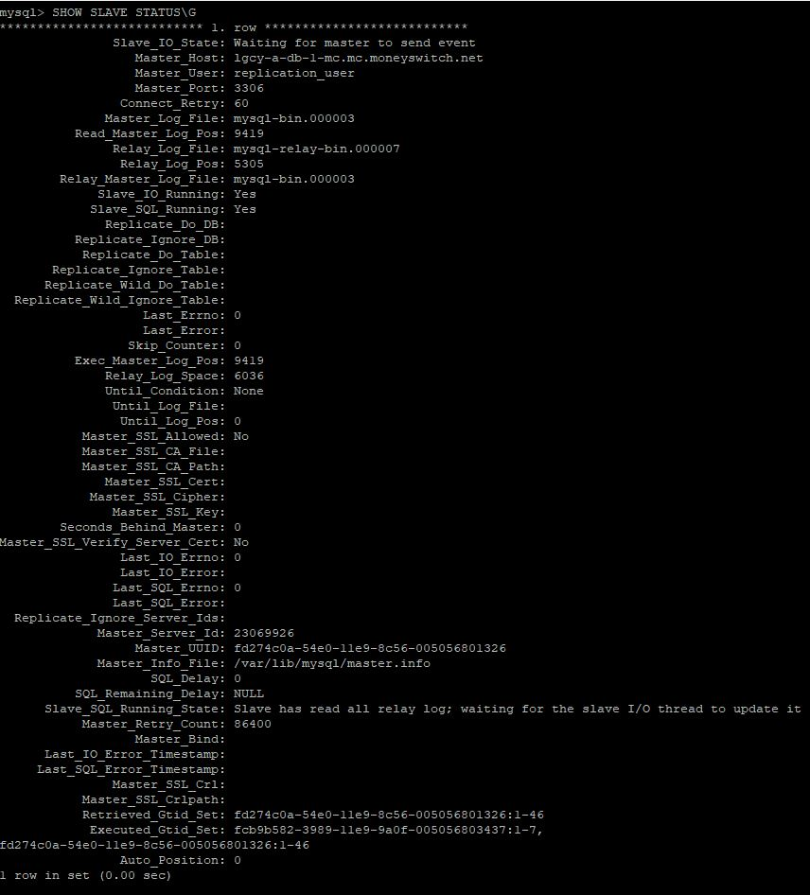
New Slave Status

Slide 6
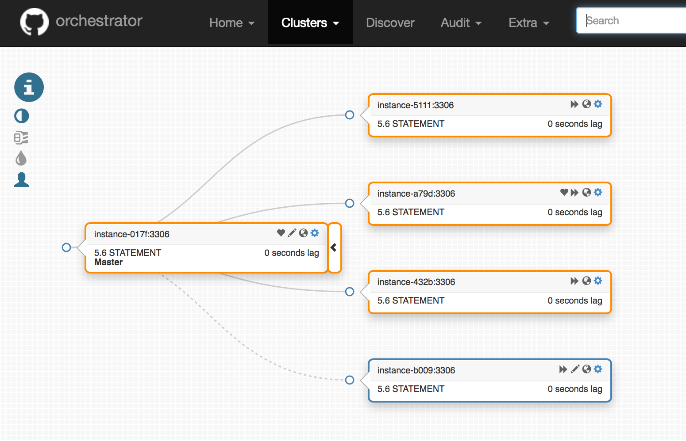
GUI based tool to failover.

Slide 7
Questions???

